Slide 1
Eigenvalues and Eigenvectors
4.1 Eigenvectors and eigenvalues
Bumhee Cho

Slide 2
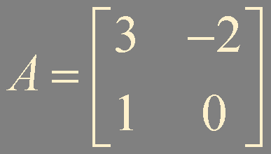
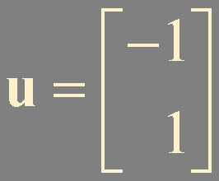
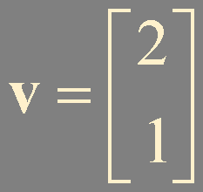
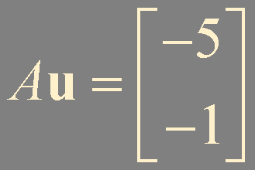
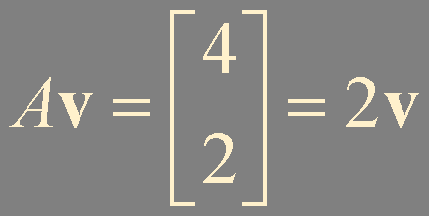
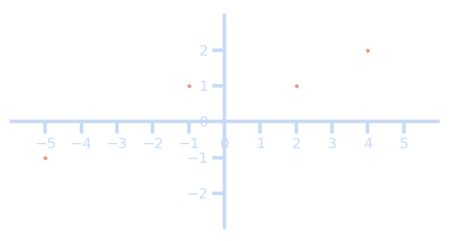
Av = 2v
u
v
Au

Slide 3
Eigenvector
An eigenvector of an n × n matrix A is a nonzero vector x such that Ax = λx for some scalar λ
A scalar λ is called an eigenvalue of A if there is a nontrivial solution x of Ax = λx;
such an x is called an eigenvector corresponding λ

Slide 4
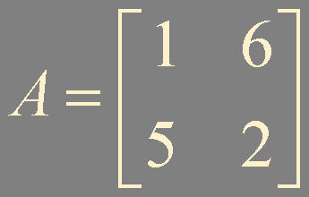
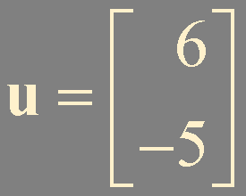
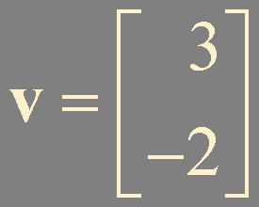
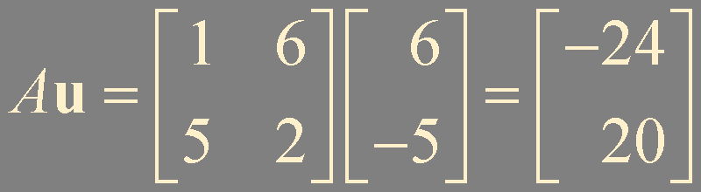
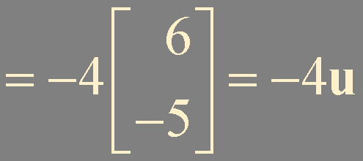
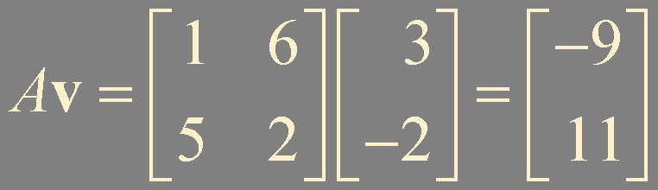
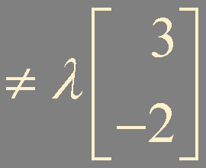
Example 1. Are u and v eigenvectors of A?

Slide 5



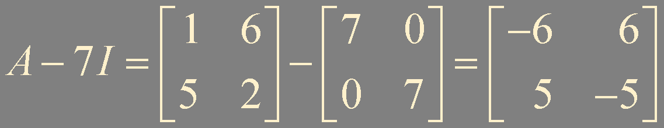
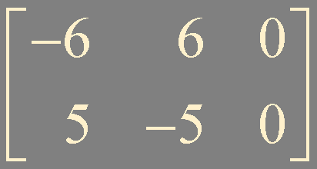
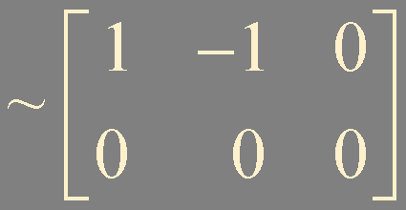
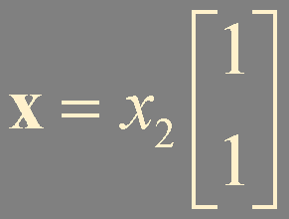
Example 2. Show that 7 is an eigenvalue of A, and find the corresponding eigenvector

Slide 6
Eigenspace
λ is an eigenvalue of A if and only if the equation
(A-λI)x = 0 has a nontrivial solution
Eigenspace of A corresponding to λ is
the null space of the matrix A-λI
zero vector
eigenvectors corresponding to λ

Slide 7
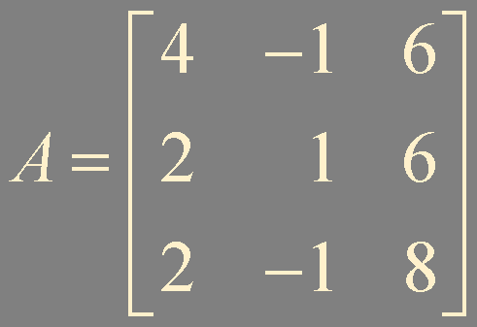
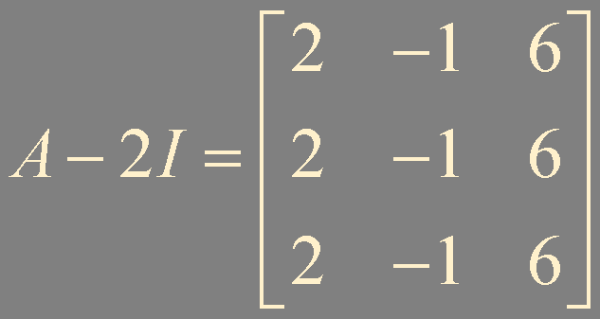
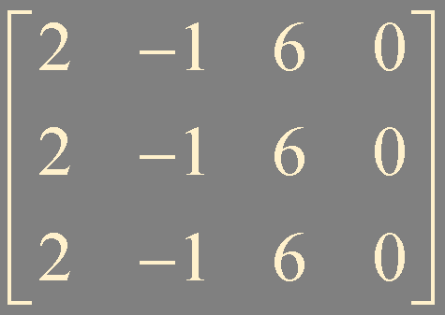
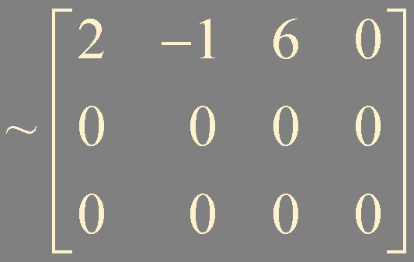
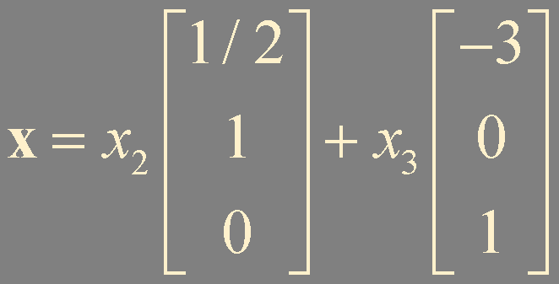
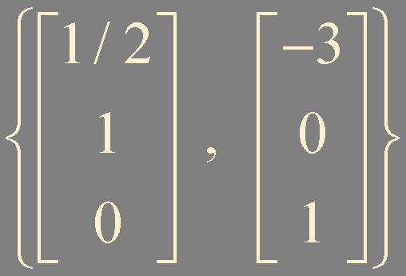
Example 3. λ = 2, find a basis for the corresponding eigenspace

Slide 8
multiplication by A
eigenspace for λ = 2
eigenspace for λ = 2

Slide 9
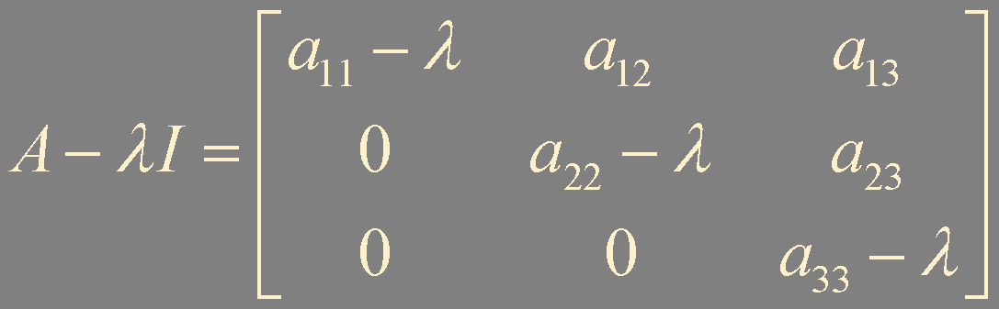
Theorem 1.
The eigenvalues of a triangular matrix are the entries on its main diagonal
(A-λI)x = 0 has a nontrivial solution
if and only if the equation has a free variable (not invertible)

Slide 10
(A-λI)^{T} = A^{T}-(λI)^{T} = A^{T}-λI
(A-λI)^{T} is not invertible
(A-λI) is not invertible
(A^{T}-λI) is not invertible
λ is an eigenvalue of A^{T} if and only if λ is an eigenvalue of A

Slide 11
λ = 0
Ax = λx
Ax = 0
0 is an eigenvalue of A if and only if A is not invertible

Slide 12
Theorem 2.
If v₁, … , v_{r} are eigenvectors that correspond to distinct eigenvalues λ₁, … , λ_{r} of an n × n matrix A, then
the set {v₁, … , v_{r}} is linearly independent
Suppose {v₁, … , v_{r}} is linearly dependent
CH1. Theorem 7.
Characterization of Linearly Dependent Sets
c₁v₁ + ⋯ + c_{p-1}v_{p-1} = v_{p}
An indexed set S = {v₁, … , v_{p}} of two or more vectors is linearly dependent and v₁ ≠ 0,
A
c₁λ₁v₁ + ⋯ + c_{p-1}λ_{p-1}v_{p-1} = λ_{p}v_{p}
then some v_{j} (with j>1) is a linear combination of the preceding vectors, v₁, … , v_{j-1}
λ_{p}
c₁λ_{p}v₁ + ⋯ + c_{p-1}λ_{p}v_{p-1} = λ_{p}v_{p}
c₁(λ₁-λ_{p})v₁ + ⋯ + c_{p-1}(λ_{p-1}-λ_{p})v_{p-1} = 0

Slide 13
Summary
Eigenvector
Eigenvalue
Eigenspace

